Slide 1
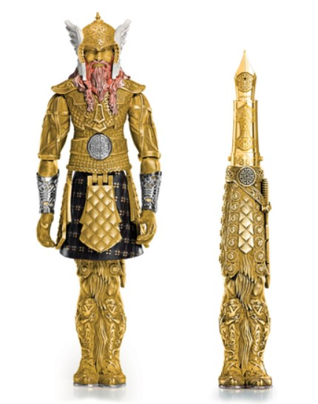
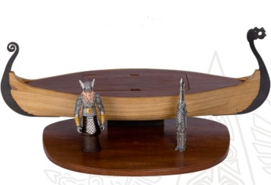
Montegrappa's team of artisans has blended military lore and Norse mythology to recapture a figure that spread fear across the Northern latitudes more than a millennium ago.
Montegrappa Fountain Pen
Limited Edition box
$18,000
Special Features
Renowned for the mastery of technique and creativity
Handmade using traditional techniques
Gold, silver, natural lacquers, precious and expensive material used
Highly sought after collections for lovers of fine objects.
Best Deal
20% Off
Fountain
Contact : 1 (800 )-000-0000
Buy on Amazon.com
www.montegrappa.com

